Slide 1
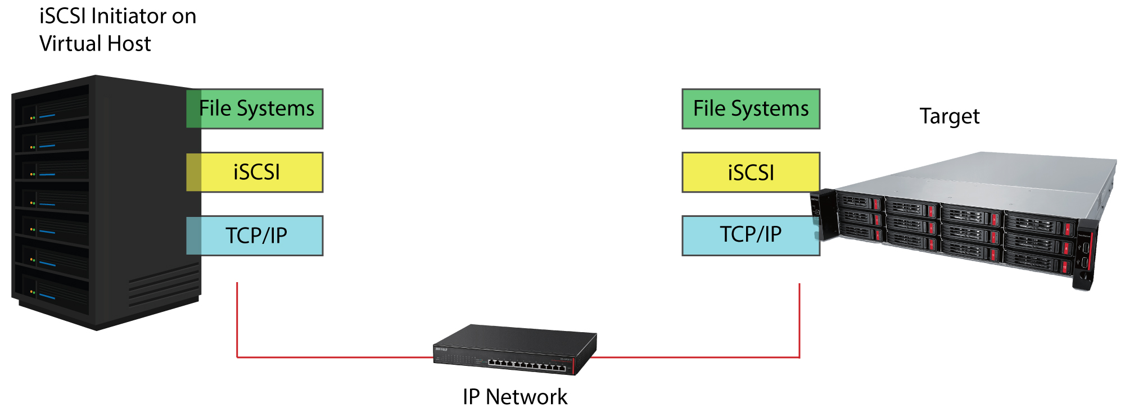
What is iSCSI and why is it a major selling point for NAS?
How Can a Hybrid Cloud Strategy Benefit Your Customer?

Slide 2
Founded in 1974 - 40+ years
Headquarters - Nagoya, Japan
Publically Traded on Tokyo Stock Exchange
North American HQ – Austin, TX
Award winning North American Tech Supporta
Committed to SMB
Purpose Built Engineered Products & Solutions
Dedicated Pre & Post sales resources
Network Storage & Networking Product Strength

Slide 3
Details about iSCSI
What is iSCSI?
In short, it is an interface (Internet Small Computer Systems Interface) iSCSI.
It is used so that a host (server) can see a storage media and interact with it.
RAID5
Save yourself the hassle of calling different manufacturers for drive or chassis support

Slide 4
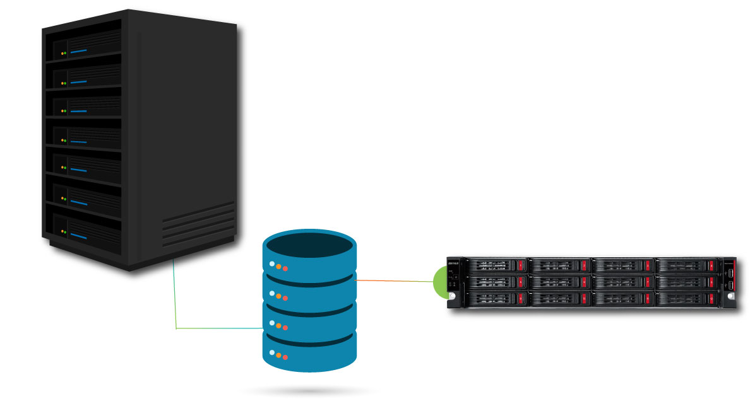
Details about iSCSI
Why is iSCSI relevant?
iSCSI offers the best performance value for adding storage space to a host (server).
RAID5
Save yourself the hassle of calling different manufacturers for drive or chassis support

Slide 5
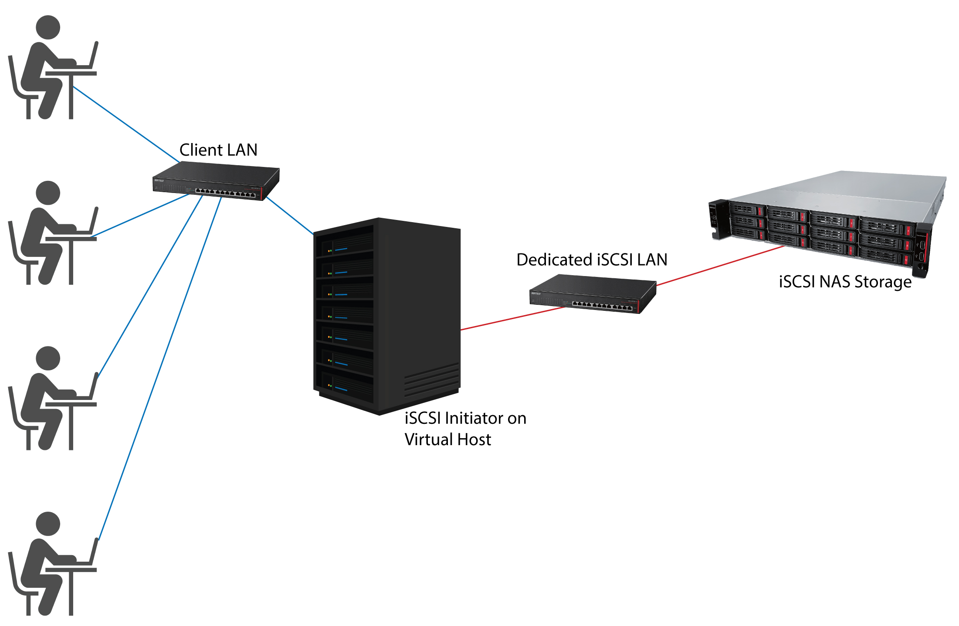
Details about iSCSI
How does iSCSI add storage space to a host (server) while maintaining strong performance?
iSCSI improves PC performance in the network by allowing large storage arrays to connect to client systems without the need for custom hardware or cabling
RAID5

Slide 6
Performance in a Virtual Environment
Benefits
iSCSI offers the best performance value for adding storage space to a host (server)
Can provide large amounts of storage to a host (server)
No need to add drives to the host itself
Doesn’t sacrifice performance
Can use existing networking equipment
No need to learn fiber SAN topology configuration
RAID5
Save yourself the hassle of calling different manufacturers for drive or chassis support
* A virtual environment is when an operating system creates an environment to host virtual machines (computers).

Slide 7
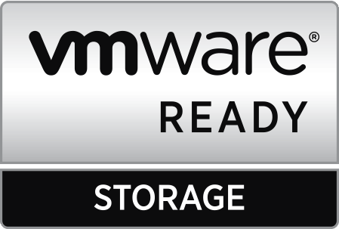
Importance of iSCSI VMware Ready
Why is iSCSI significant to VMware?
VMware ESX provides native support for iSCSI targets. iSCSI is a popular storage option for ESX hosts.
What is VMware Ready?
RAID5
As stated on VMware.com:
VMware Ready designates VMware's highest level of endorsement for products created by our established partners. VMware Technology Alliance Partner members can develop their products to meet VMware standards and submit them for test and review. The VMware Ready certification tests are specifically designed for each category to ensure customer confidence.
Save yourself the hassle of calling different manufacturers for drive or chassis support
If you contact VMware support for assistance with an unsupported storage solution, their ability to help you will be limited
Notes:
Mike

Slide 8
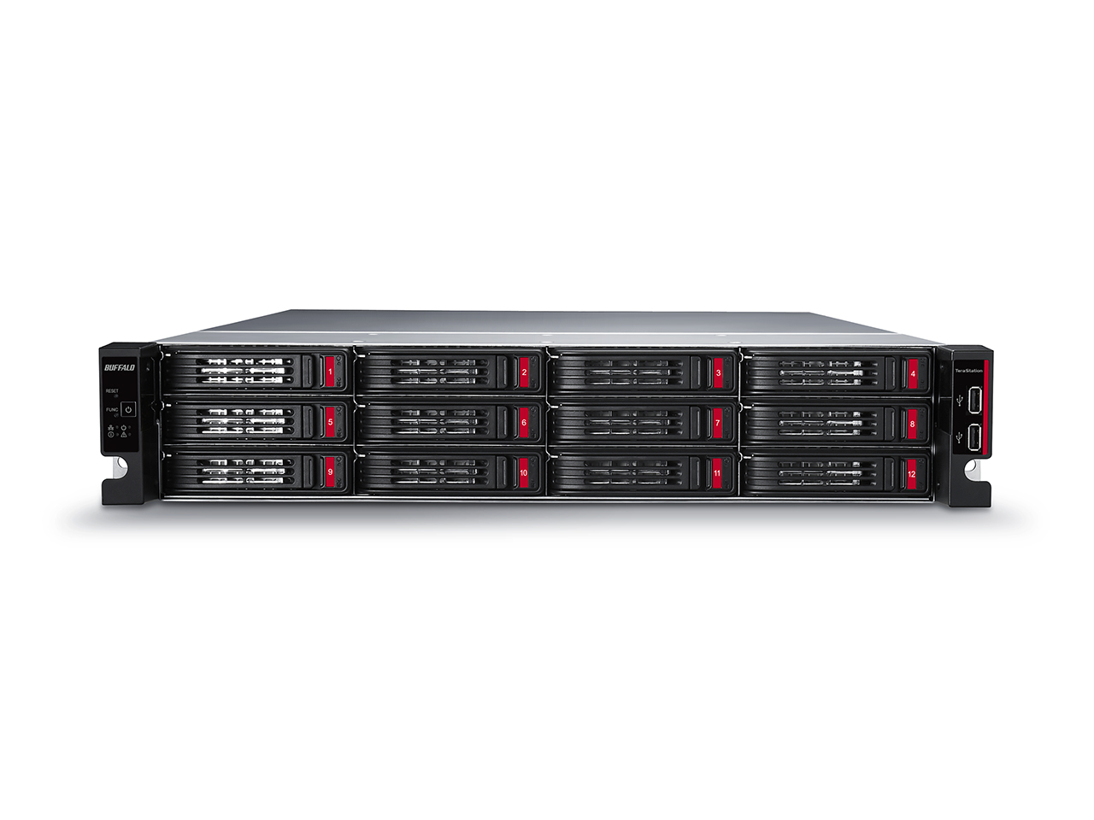
Maximize ROI on your NAS/SAN investment – NO BUDGET?
TeraStation™
Buffalo’s TeraStation series provides both enterprise and business level NAS and iSCSI storage for businesses looking to implement high performance, low cost, compatible RAID based network storage solutions at SMB price points.
Delivering enterprise level performance, TeraStations are an excellent choice as a backup storage target for more costly SAN appliances. TeraStation pricing allows customers to maximize ROI on their SAN investments. Popular solutions include:
• Increased local network storage capacity, up to 120TB
• High performance file sharing and backup
• Virtualized backup target using data protection software like vRanger and Veeam
• Differential file level replication for branch office support and disaster recovery scenarios
RAID5
Store older, less frequently accessed data on the TeraStation™ 51210RH
Users can experience the same high performance data
access on the TeraStation 51210RH as they would with the SAN

Slide 9
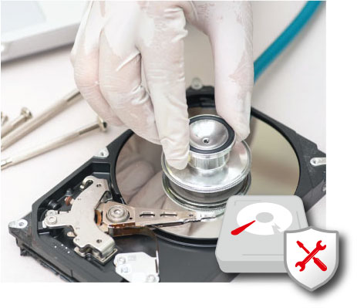
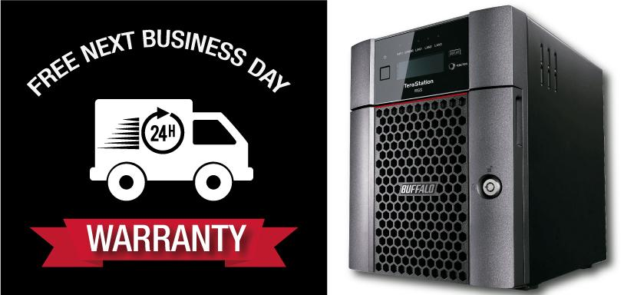
Benefits of Registering Your Product
Buffalo’s Data Recovery Service
Many of our products qualify for our data recovery service for simple logical data issues.
To receive this service, the device must be registered within its original warranty terms.
RAID5
Free Next Business Day Warranty Promotion
You cannot predict when failure will happen, but you can safeguard Our Next Business Day Warranty ships replacement product to your business the next day, helping you reduce downtime. Product must be registered within 30 days or purchase. Exp. 12/31/2018

Slide 10
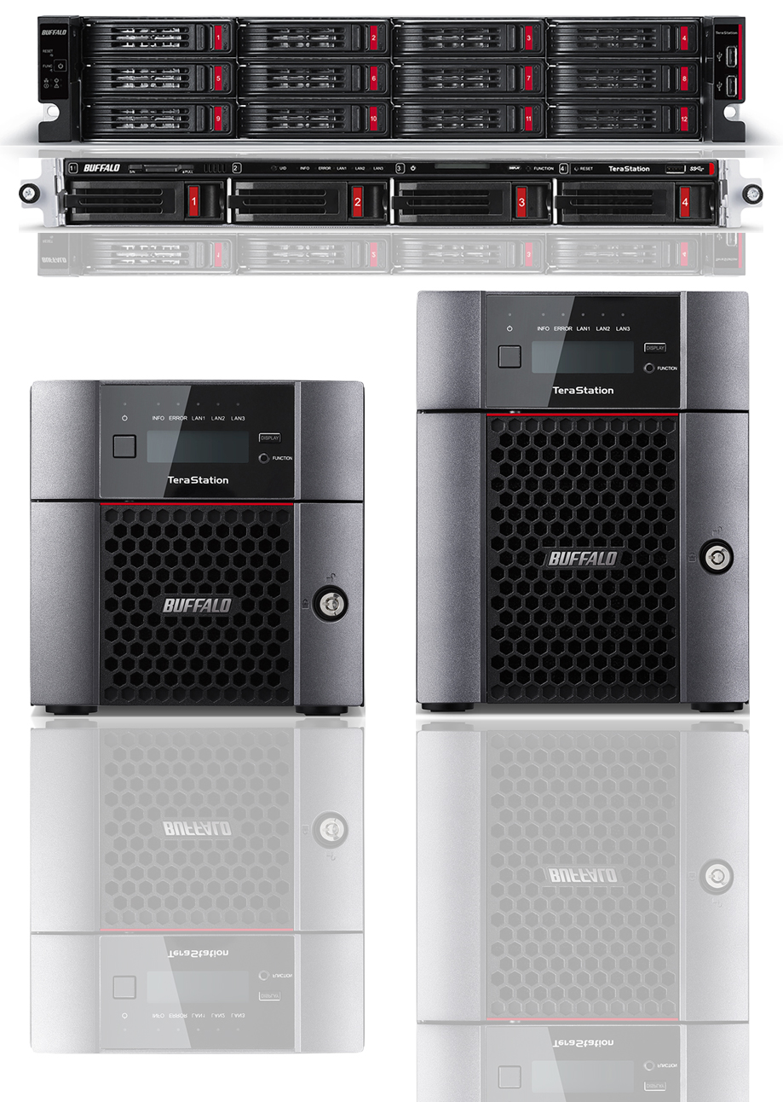
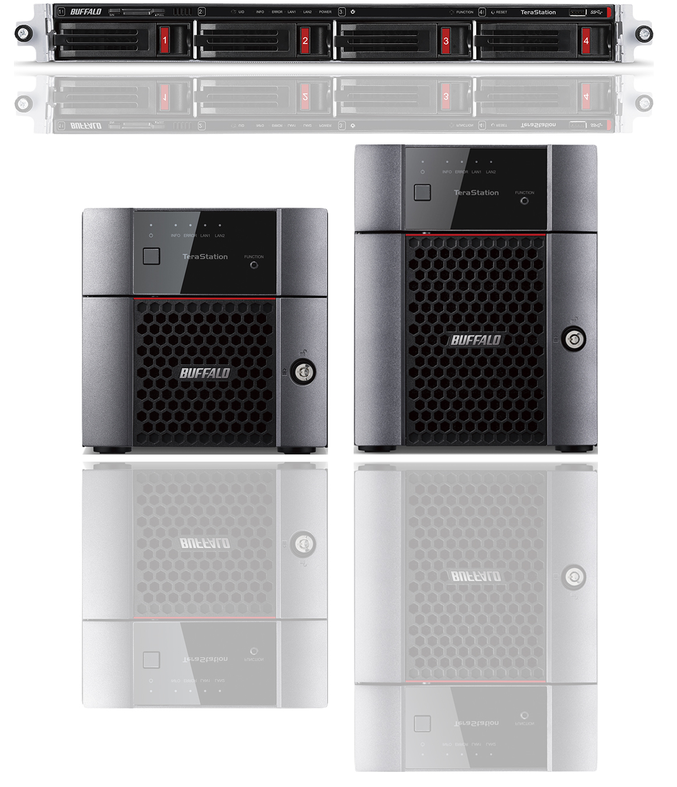
New Buffalo NAS Products
TeraStation
3010 series
TeraStation
5010 series
Use Cases
Client Backup
Migrating old servers
Disaster Recovery
Replication
Storage Virtualization
Surveillance Solutions
Failover
Window Storage Server
Cloud Integration
Vertical Markets
Government – Federal and State and Local – TAA Compliant
Corporate –Small Business
Healthcare
Education and more

Slide 11
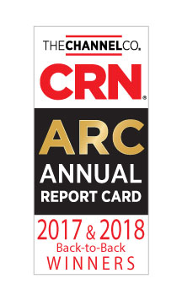
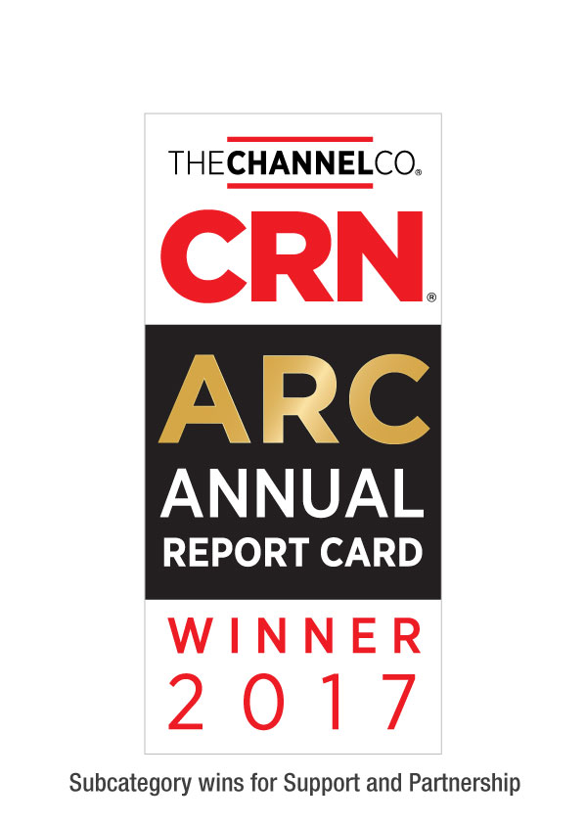
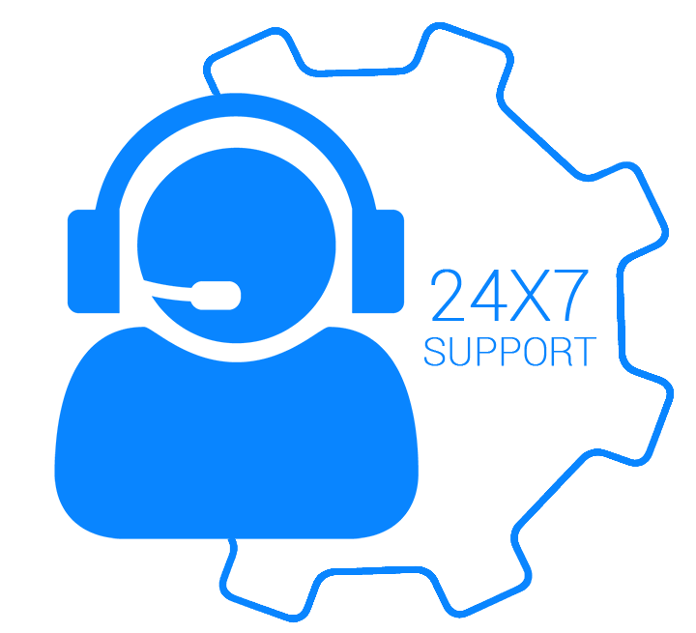
Buffalo Tech Support
Best support will bring your customer back again.
Award winning US-based technical support
Your customers are in award-winning hands with every purchase.
24/7 North American-Based Phone Support
Easy support access for your customers.
FAQs and easy-to-understand walkthroughs
Find answers to common and not-so-common questions at our knowledge base:
Step by Step setup instructions for all TeraStation features
www.buffaloamericas.com/knowledge-base
Up to 60 clients
With full access

