Slide 1
Data Management - Working Remote
Why is data backup & security a factor
How Can a Hybrid Cloud Strategy Benefit Your Customer?
Notes:
mark

Slide 2
Welcome
Today’s Presenters
Mark Green –
Buffalo Account Manager
Gary Thomas –
Buffalo Sales Engineer
Nathan Fouarge–
NovaStor VP of Strategic Solutions
Notes:
mark

Slide 3
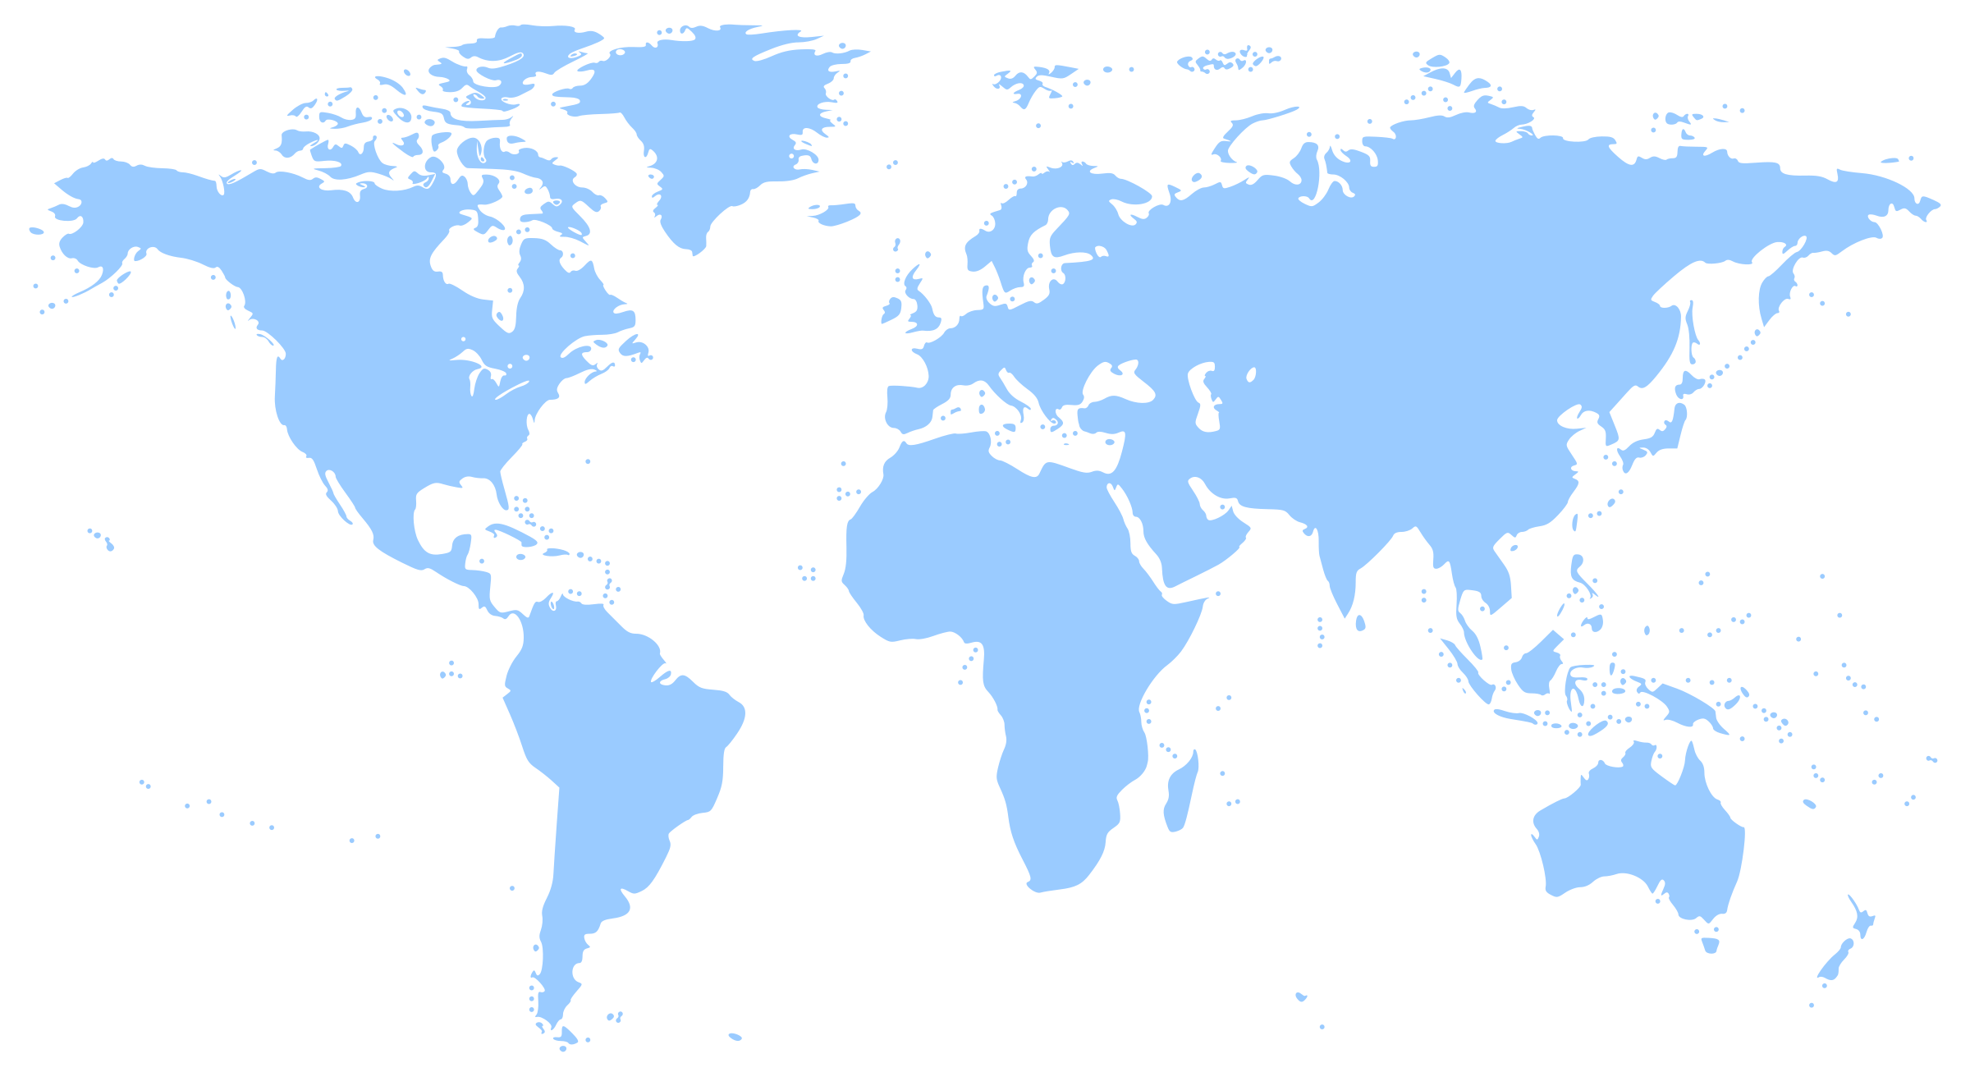
Founded in 1974 - 45+ years
Headquarters - Nagoya, Japan
Publically Traded on Tokyo Stock Exchange
North American HQ – Austin, TX
Award winning North American Tech Support
Committed to SMB
Purpose Built Engineered Products & Solutions
Dedicated Pre & Post sales resources
Network Storage & Networking Product Strength
Notes:
mark

Slide 4
Data management while remote
Why is data backup and security a key factor in successful remote work?
Many businesses have been forced to change and/or improvise remote working environments for their team members, sometimes at very short notice. This has resulted in displaced IT infrastructure and operations.
RAID5
Amidst the chaos of remote work and technical disruptions, you may not be aware of data security vulnerabilities that might arise, which attackers will be more than happy to take advantage of.
Notes:
gary

Slide 5
Data management while remote
How is data security different when working remote?
Without a centralized data repository for backup, the risk of suffering data loss increases dramatically.
Working from home means you will have to be more diligent with backups, but it is worth it for your protection.
RAID5
Save yourself the hassle of calling different manufacturers for drive or chassis support
Notes:
gary

Slide 6
Data management while remote
How is data security different when working remote?
Regardless of the size of your business, failing to encrypt your communication sufficiently could be an easy way for attackers to breach your network and access your business data.
Employees working from home are no longer protected by the preventive security controls at the office.
RAID5
With remote work, large amounts of data will be moved online, and you will need to choose your online services carefully.
Save yourself the hassle of calling different manufacturers for drive or chassis support
Notes:
gary

Slide 7
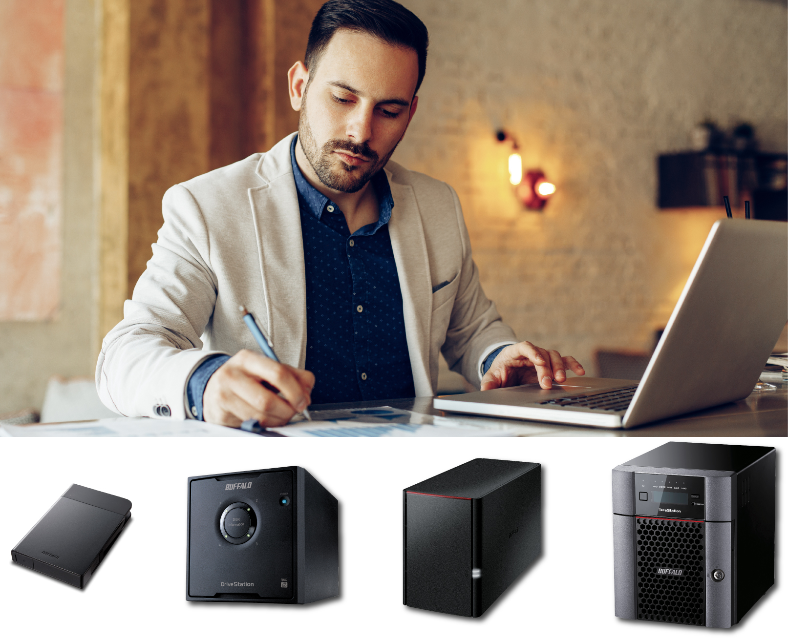
Data management while remote
How is data security different when working remote?
Protecting your data while working from home is an essential part of successfully maintaining your business. Safeguarding your data with a large remote workforce will not be easy, but it doesn't have to be complicated or expensive either.
RAID5
Notes:
gary

Slide 8
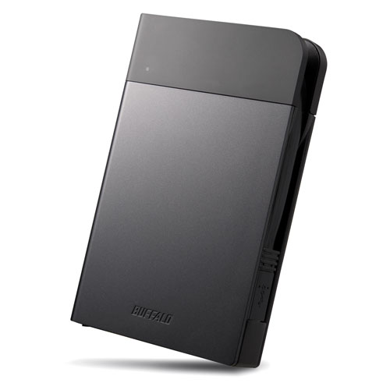
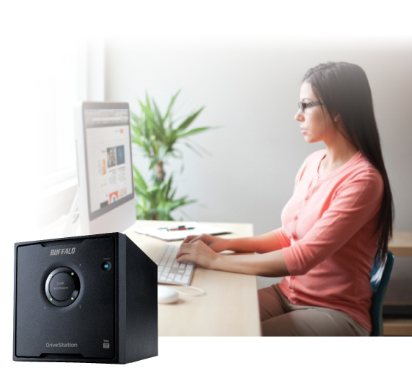
A Good Option – USB Drive
Regardless of what systems your users have, most
operating systems include a built-in option to back up the system to an external drive
RAID5
Buffalo has several options, both portable and desktop, to accommodate whatever data needs you have ranging from a simple 1TB portable USB drive up to a RAID 5 backed desktop drive with 18TB of usable space
Notes:
gary

Slide 9
A Better Option - NAS
The LinkStation SOHO includes five licenses for Novastor NovaBackup desktop and is available with either 2TB or 4TB of usable space to accommodate most backup needs.
This device also qualifies for Buffalo’s Data Recovery Service and 3 year warranty.
RAID5
Notes:
gary

Slide 10
The Best Option - NAS
Buffalo TeraStation devices are available with up to 48TB of usable space in our desktop devices and can handle all of your remote users backup needs. They include ten licenses of Novastor NovaBackup desktop in addition to one license of NovaBackup for servers.
All desktop TeraStations include high quality NAS class hard drives, AES256 encryption, and can be remotely managed using the Buffalo Remote Management Service so that your admins will always know if there is a problem.
RAID5
Notes:
gary

Slide 11
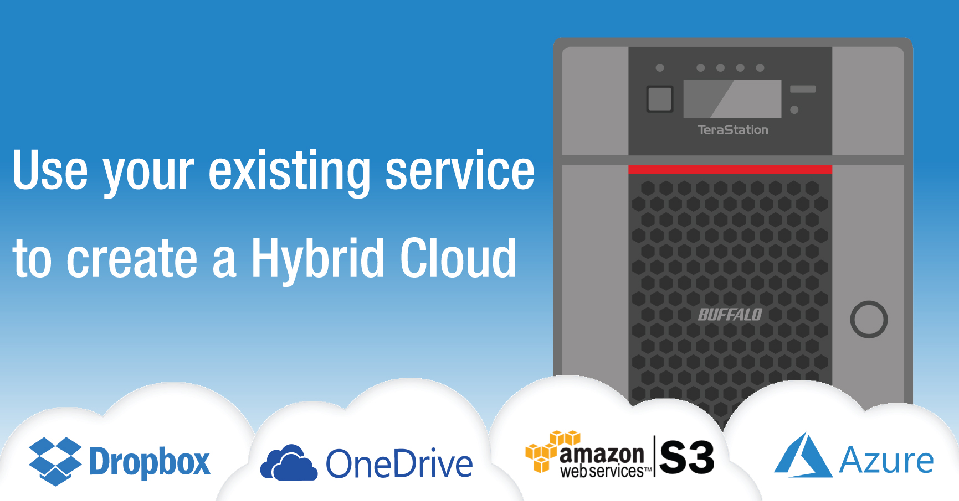
Hybrid Cloud - NAS
Get more centralization of user backups
Leverage existing cloud resources
Fast access to your data
Easy to integrate
RAID5
Notes:
gary

Slide 12
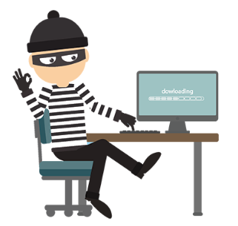
Endpoint data protection
With the Work From Home order, critical data is dispersed and therefore exposed to exponential risks:
Hacking and Phishing Schemes
Remote Employee Security
Sick or Stressed Employees
Our advice is….
Stay in touch with your customers. Offer them help to review their remote environment.
Notes:
Endpoint data protection
With the Work From Home order, our critical data is dispersed and therefore exposed to exponential risks:
Hacking and Fishing Schemes
Hackers have been preying upon the fear and anxiety surrounding the COVID-19 virus to obtain access to private data and deliver ransomware.
Remote Employee Security
Remote workers must be reminded to secure and back up their sensitive data in order to prevent risks to their companies.
Sick or Stressed Employees
Stress can lead to human error, which is one of the leading causes of data loss. Another risk is a short-staffed security team that could mean applications not being updated or security holes.
What can you do now?
We at NovaBACKUP advise you to stay in touch with your customers and offer help to review their environment.

Slide 13
Secure your customers’ data remotely
1) Perform remote backups with NovaBACKUP Cloud
2) Monitor with our Central Management Console
3) Follow the 3-2-1 rule – Simple and Dependable!
Have 3 copies of your data
Stored on 2 different types of media
With 1 kept off-site (cloud for example)
The NovaBACKUP C-Mon is a complimentary tool
Notes:
Secure your customers’ data remotely
Perform remote backups with NovaBACKUP Cloud
Backing up critical data both locally and in the cloud is the best way to defend individuals and businesses against ransomware and disasters
Monitor with our Central Management Console
Keep an eye on one or thousands of backup jobs from a single web-based interface, accessible from anywhere.
Follow the 3-2-1 rule – Simple and Dependable!
Have 3 copies of your data
Stored on 2 different types of media
With 1 kept off-site (for example in the cloud)

Slide 14
Exclusive Offer for Buffalo Partners
Add cloud storage to your current NovaBACKUP license
Sign up as an MSP with NovaBACKUP hosted data storage, with no license fees.
Host the cloud yourself for FREE through the end of Q2.
Contact us to learn more
Adam Stuflick
NovaBACKUP Cloud Business Manager
adam.stuflick@novastor.com
+1-805-579-5446
Notes:
1) Add storage to your current NBK license ​ 2) Sign up as an MSP with NovaBACKUP hosted, no license fees. $.10/GB min $160 ​ 3) Host the cloud yourself for Free through the end of Q2, and then pay $.04/GB min $160

Slide 15
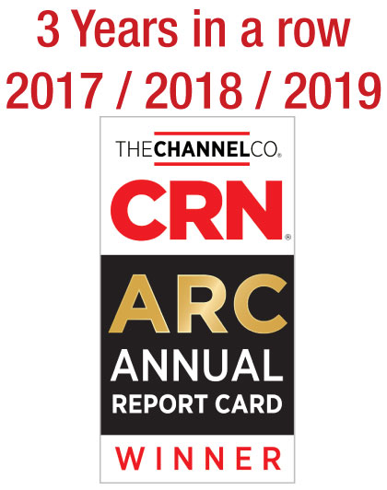
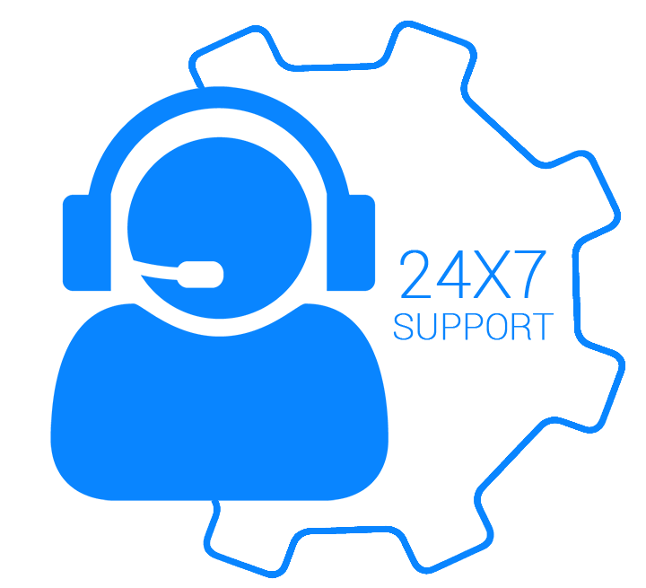
Buffalo Tech Support
Our support team will help keep your data secure
Award winning US-based technical support
You are in award-winning hands with every purchase.
24/7 North American-Based Phone Support
Easy support access.
FAQs and easy-to-understand walkthroughs
Find answers to common and not-so-common questions at our knowledge base:
Step by Step setup instructions for all TeraStation features
www.buffaloamericas.com/knowledge-base
Up to 60 clients
With full access
Notes:
mark

Slide 16
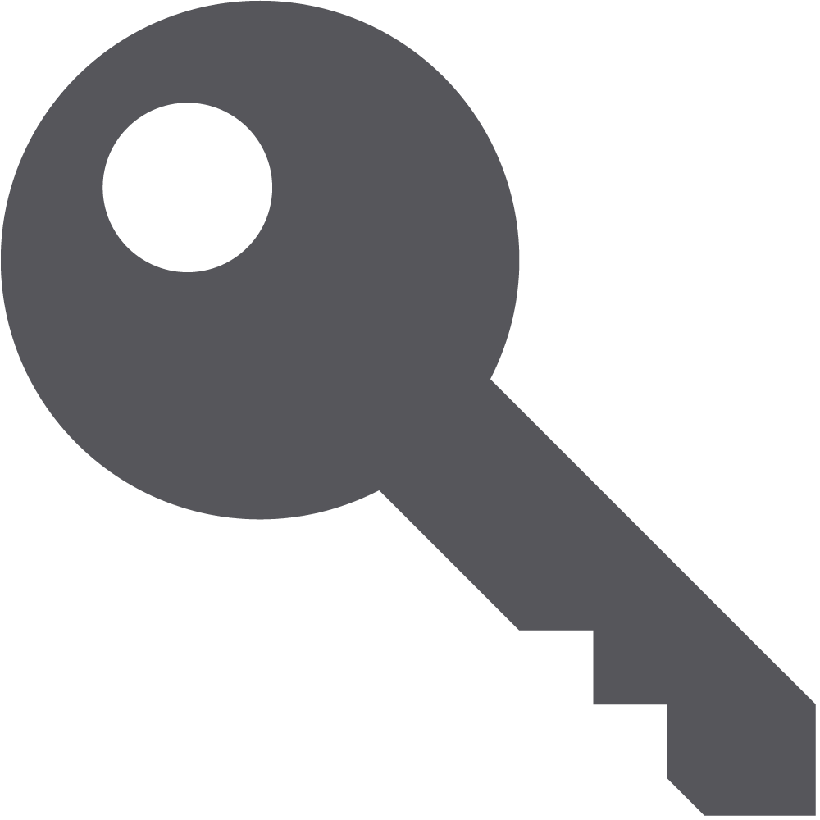
TeraStation
Purpose Built SMB Storage
Relevant Purpose-built Solution
Many TeraStation storage devices are designed for use by Small Business, SMB, and entry-level Enterprise environments
Ease of use
Our network storage devices come with hard drives included. This means pre-configured RAID and plug and play capabilities & one stop 24x7 US based support by Buffalo
RAID5
Coverage
Dedicated Buffalo representatives standing by to help your customer identify the correct product for their needs
Price
Storage is not the first thought for most small businesses. TeraStations are purpose built for the SMB user with SMB price points in mind
Up to 60 clients
With full access
Notes:
mark

Slide 17
Update
Any Questions?
Contact Information
Mark Green
512-349-1368
Mark.Green@BuffaloAmericas.com
Contact Information
Adam Stuflick
805-579-5446
Adam.Stuflick@NovaStor.com
Notes:
mark

